Slide 1
Phresco Testing Framework
Automation Tool - Robotium

Slide 2
Agenda
Basic Introduction to Robotium
Supported devices/versions
Advantages of using Robotium
Pre-requisites and Environment setup
Folder structure followed in Phresco
Sample Test case creation
Achievements and RoadMap

Slide 3
What is Robotium?
Robotium is an open source automation testing tool used for testing Android native applications.
Makes it easy to write powerful and robust automatic UI test cases for Android applications
Can be used for testing applications where either
the source code is available or
only the APK file is available.

Slide 4
Supported Versions/Languages/OS
Supported by Java alone.
Can be run only in Android OS only(Officially supports Android 1.6 and up )
Tests can be run on both emulator and device.

Slide 5
Advantages of using Robotium
Can develop powerful test cases, with minimal knowledge of the application under test
Handles multiple Android activities automatically
Minimal time needed to write solid test cases.
Readability of test cases is greatly improved, compared to standard instrumentation tests.
Test cases are more robust due to the run-time binding to GUI components.
Integrates smoothly with Maven or Ant to run tests as part of continuous integration.

Slide 6
Pre-requisites
Jdk(not JRE)
path for <JAVA_HOME> has to be set in environment variable
Eclipse
ADT plugin and SDK has to be installed
Android SDK
path for <ANDROID_HOME> to be set in environment variable
<ANDROID_HOME> /tools and <ANDROID_HOME>/platform-tools as system PATH variable.

Slide 7
Download Location
JDK installation
http://www.oracle.com/technetwork/java/javase/downloads/index.html
Eclipse installation
http://www.eclipse.org/downloads
Download Android SDK
http://developer.android.com/sdk/index.html

Slide 8
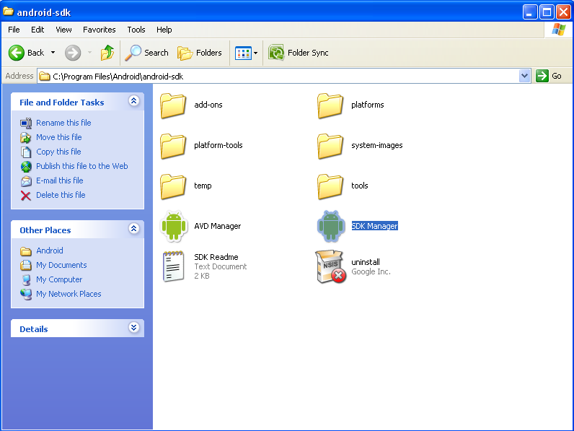
Environment Setup
SDK Installation and Device Setup

Slide 9
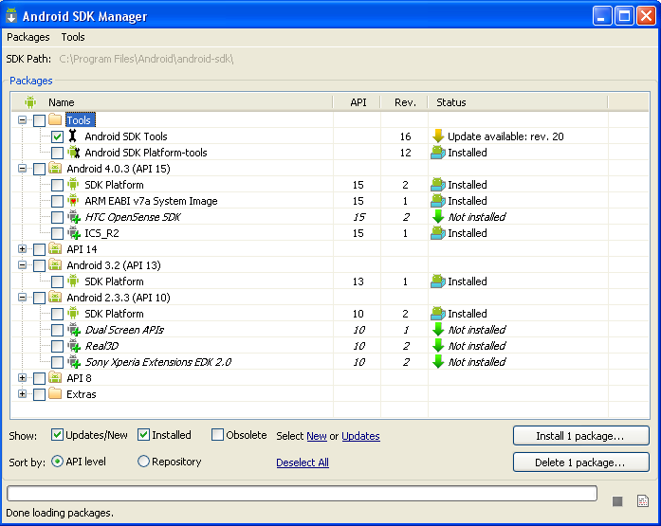
SDK Installation-(Contd)
SDK Installation-(Contd)
Note: Latest version of SDK and AVD can also be installed from eclipse.

Slide 10
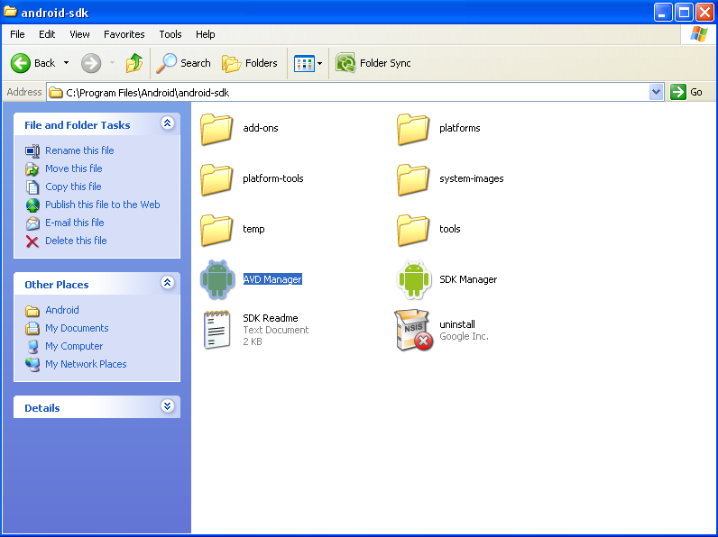
Device Setup
Android virtual device(AVD) manager is used to setup the device to launch android application. This can be added by selecting the AVD manager from <ANDROID_HOME> path.

Slide 11
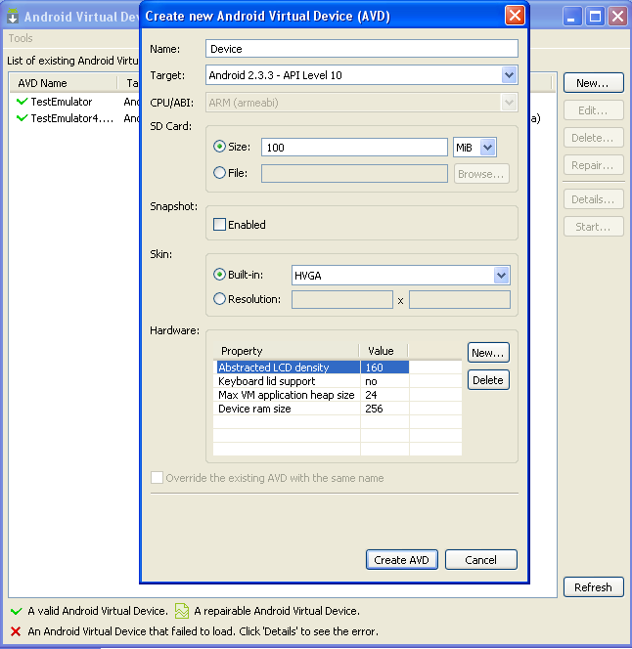
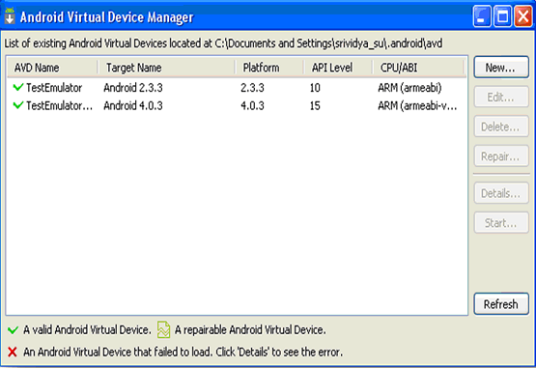
Device Setup-Contd

Slide 12
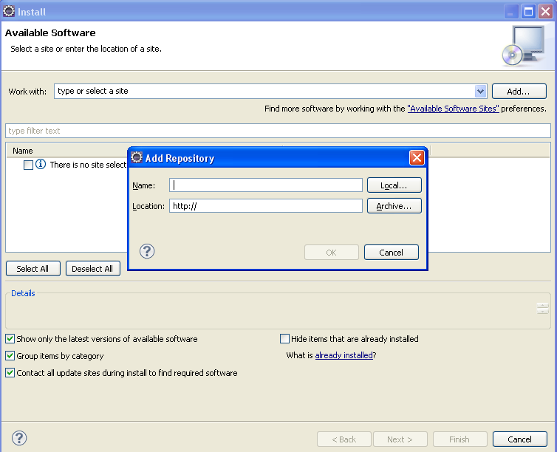
Eclipse Setup
ADT Plugin Installation:
Go to Help-->Install New Software-->Click “Add”

Slide 13
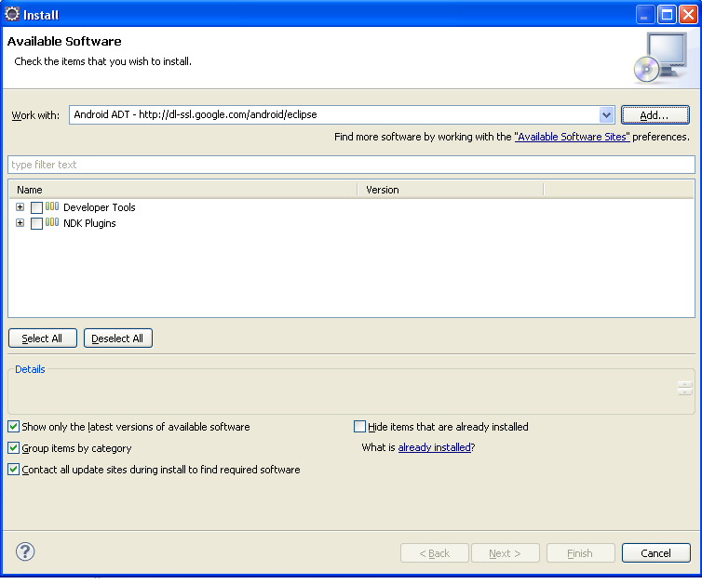
Eclipse Setup-Contd

Slide 14
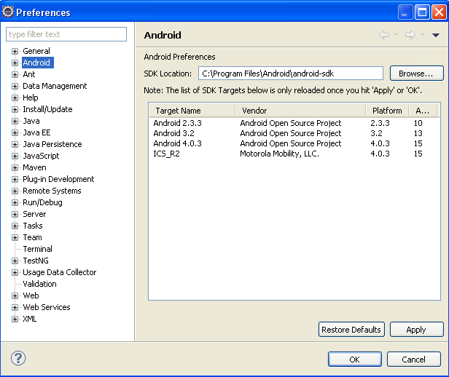
Eclipse Setup-Contd
Also, make sure,SDK 's location is also configured in Eclipse. This can be done as below:
In Eclipse--> Windows-->Prefrences-->Click on “Android”

Slide 15
Steps to Write a Test
Import your source code into eclipse.
Deploy the application to device
Create a test project, test class
Add “robotium jar” to your build path
Execute your test case

Slide 16
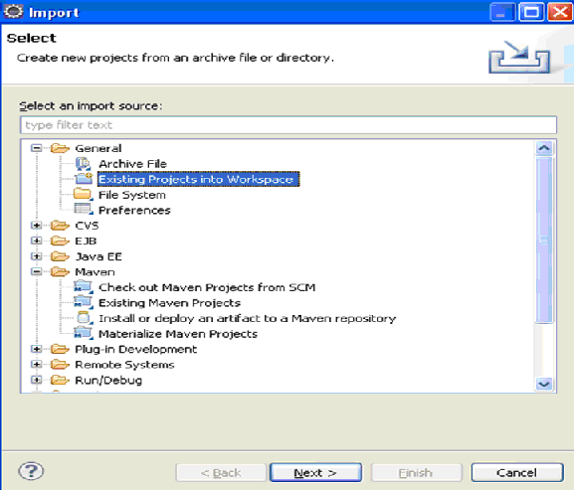
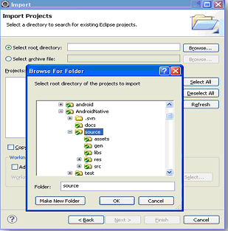
Importing Source code into Eclipse
In Eclipse-->File-->Import

Slide 17
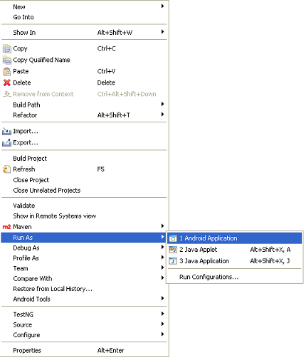
Deploying Application to device
Right click on the application imported->run as->Android application, will deploy Android application in the device.

Slide 18
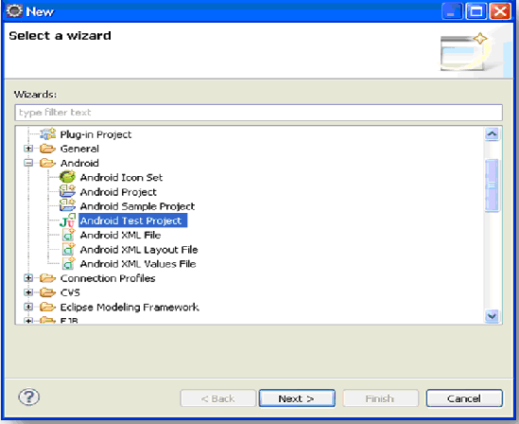
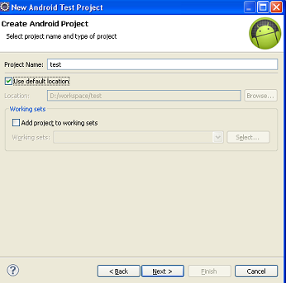
Create a Test Project
Click File->new->other-->Select “Android Test Project” as shown:

Slide 19
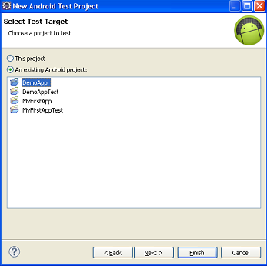
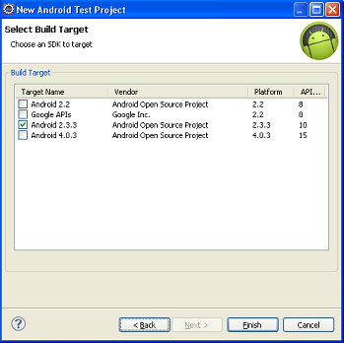
Create a Test Project-Contd

Slide 20
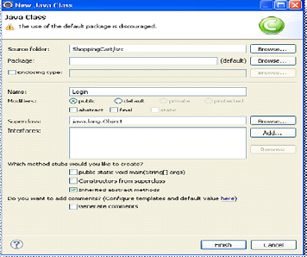
Creating a new Class
In Eclipse ,Right click on the package->New->Class, will create a new class file for the application.

Slide 21
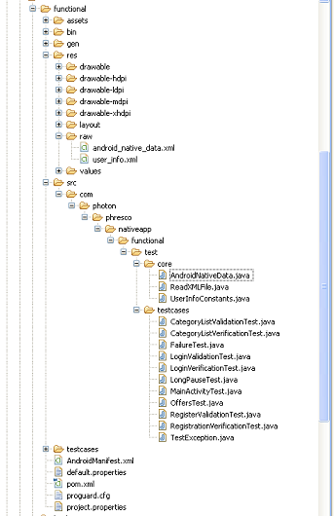
Functional test folder structure
Raw data and User Inputs
Constant values used to describe the roles of various UI objects in an application
Test Cases
pom.xml to mention dependencies
Pom.xml

Slide 22
Steps to create Robotium test cases
Capturing ID's
ID's will be obtained from R.java under source code
(/source/com/photon/phresco/nativeapp/R.java)
Constant Declaration
Constants will be maintained under
/src/com/photon/phresco/nativeapp/functional/test/core directory
Inputs assigned to constants
Raw data will be maintained under /res/raw
Testcases
MainActivity test: Main activity test is the root folder that calls all the test cases written separately.This initiates the testing process.
Test cases : Test cases are the test methods that are called by the main activity test. Test cases can be many in number
All the Junit Test cases will be maintained under /src/com/photon/phresco/nativeapp/functional/test/ directory

Slide 23
How to add Robotium jar?
Mention the jar with the required version as dependency in your pom.xml of functional folder as shown below:
<dependency>
<groupId>com.jayway.android.robotium</groupId>
<artifactId>robotium-solo</artifactId>
<version>{latest version}</version>
</dependency>

Slide 24
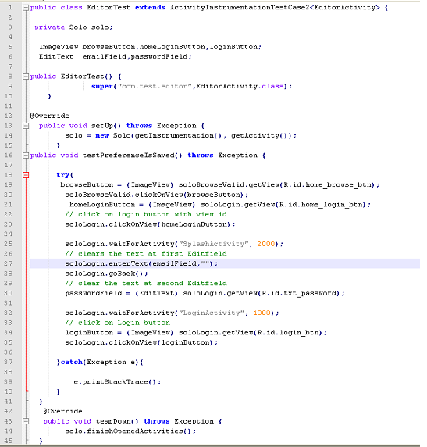
Sample Test case
Creating reference for Solo Robotium API class
Using setup() method – to start the execution of test cases
Using ID fromR.java
Using teardown() method -will close all the activities which is opened during the testcase execution.

Slide 25
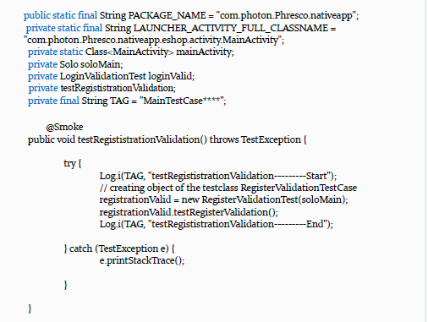
How to add a newTest case?

Slide 26
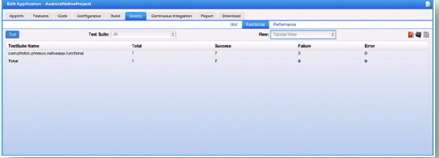
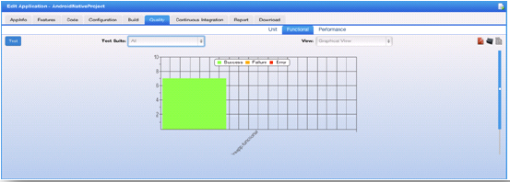
Report Generation in Phresco- Success Report

Slide 27
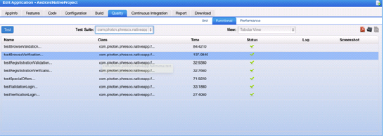
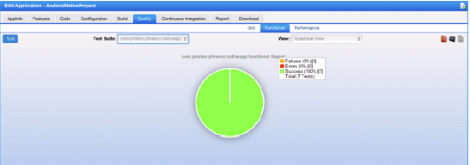
Success Report - Continued

Slide 28
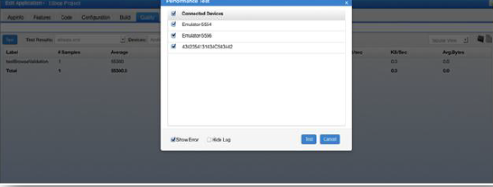
Performance Test in Phresco

Slide 29
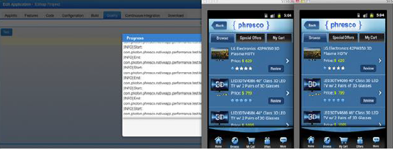
Performance Test- Cont’d

Slide 30
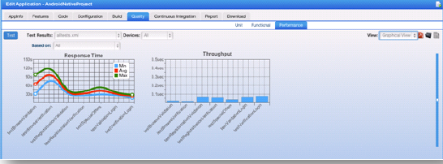
Performance Report

Slide 31
Achievements and Road Map
Phresco QA team has written automation test scripts for few accounts like
L’Oreal(Makeup.com),
JnJ(Zyrtec,Mobility…)
Walgreens(Loyalty)
Bestbuy(PDTS,DigitalDeals..)
SSBT(CRA,BPC,IVL,SRE,DGF)
NBO1(MyTouchtunes,Karaoke)
VWR(Widget and Android applications)
NetSmart,
HorizonBlue(Corporate Website)

Slide 32
Achievements and Road Map-Contd
Support for Monkey Talk(Android Hybrid applications) in 2.0
Support for running functional test cases using Jenkins through CI(Continuous Integration) in 2.0

Slide 33
Q & A For queries, contact phresco-support@photoninfotech.net

